Slide 1
Iteration loops Cycle Repetition

Slide 2
Objective
Use of for
Use of while
Use of do while loops
Multiple loop variables
Use of jumping statements

Slide 3
Loops
Iteration statements (also called loops) allow a set of instructions to be repeatedly executed until a certain condition is reached.
For Loop
While Loop
Do While Loop
for and while are entry control loops, because the condition is checked before execution of a single statement and the do – while loop is exit control, loop will always execute at-least once, either condition is FALSE or TRUE.

Slide 4
The for Loop
the 'for' loop is a control flow statement that is used to repeatedly execute a block of code as many times as instructed. It uses a variable (loop variable) whose value is used to decide the number of repetitions.
Syntax
for(initialization; condition; step) statement;
initialization: initialize the control / counter variables
condition: condition is an expression to terminate loop
step: increment / decrement the counter variable here
Example to print from 1 to 10
for(int i=1;i<=10;i++) printf(“ %d”,i);
Example to print table of 10
for(int i=1;i<=10;i++) printf(“ %d”,i*10);

Slide 5
for Loop Variations
All arguments in for loop signature are optional. for(;;); is OK and known as infinite for.
for(;;) printf(“Infinite For ”); //OK
A statement may be empty. This means that the body of the for loop (or any other loop) may also be empty.
for(;;); //No Error
In C99 and C++, but not in C89, it is possible to declare variables within the initialization portion of a for loop. a variable declared within a for loop will be local to that loop, and this kind of variable declaration is known as multiple loop variables.
for(int x=10;;); //Error in C89 Compiler

Slide 6
Flow Chart of for Loop
START
INITIALIZATION
CONDITION
FALSE
TRUE
BLOCK OF STATEMENTS
STEP
STOP

Slide 7
Solve These using for Loop
WAP to print the sum of all numbers up to a given number.
WAP to find the factorial of a given number.
WAP to print sum of even and odd numbers from 1 to N numbers.
WAP to print the Fibonacci series.
WAP to check whether the entered number is prime or not.
WAP to find the sum of digits of the entered number.
WAP to find the reverse of a number.
WAP to print Armstrong numbers from 1 to 10000

Slide 8
while Loop
The while loop in C allows a block of code to be executed repeatedly as long as a given condition remains true. It is often used when we want to repeat a block of code till some condition is satisfied.
Syntax: while (condition) statement;
where statement is either an empty statement, a single statement, or a block of statements. The condition may be any expression, and true is any nonzero value. The loop iterates while the condition is true. When the condition becomes false, program control passes to the line of code immediately following the loop.
Like for loops, while loops check the test condition at the top of the loop, which means that the body of the loop will not execute if the condition is false to begin with.

Slide 9
Solve These using while Loop
WAP to print the sum of all numbers up to a given number.
WAP to find the factorial of a given number.
WAP to print sum of even and odd numbers from 1 to N numbers.
WAP to print the Fibonacci series.
WAP to check whether the entered number is prime or not.
WAP to find the sum of digits of the entered number.
WAP to find the reverse of a number.
WAP to print Armstrong numbers from 1 to 10000

Slide 10
Do while Loop
The do ... while statement is a "bottom-driven" loop: first the body of the loop is executed, then the controlling expression is evaluated. This is repeated until the controlling expression is "false", or 0.
The key difference from a while statement is that a do ... while loop body is always executed at least once. A while loop may not execute at all, because its expression could be false to begin with.
Syntax
do statement while ( expression ) ;

Slide 11
Solve Using do while Loop
WAP to print the sum of all numbers up to a given number.
WAP to find the factorial of a given number.
WAP to print sum of even and odd numbers from 1 to N numbers.
WAP to print the Fibonacci series.
WAP to check whether the entered number is prime or not.
WAP to find the sum of digits of the entered number.
WAP to find the reverse of a number.
WAP to print Armstrong numbers from 1 to 10000

Slide 12
Multiple loop variables
We can declare multiple variables in INITIALIZATION clause of a for loop:
for( int a= 5,b,c=0;;); //Compiles
We can declare any no. of variables here but the scope of all these variables is limited to that for.

Slide 13
Nested Loops
Loop statement inside another loop statement are known as nested loops.
For a nested loop, the inner loop performs all of its iterations for each iteration of the outer loop.
No limits in layers of nesting's.
Syntax
LOOP 1
LOOP 2
LOOP 3
……………
END OF LOOP 3
END OF LOOP 2
END OF LOOP 1
for(int i=0; i<3; i++)
{
for(int j=0;j<4;j++)
{
for(int k=0; k<5; k++)
{
printf(“\ni= %d j= %d k= %d”,I,j,k);
}
}
}

Slide 14
Uses
Printing Patterns: Nested loops are often used to print complex patterns such as printing shapes, grids, or tables.
Searching and Sorting: Nested loops are used in algorithms that involve searching for or sorting elements like bubble sort, insertion sort, matrix searching etc.
Multi-Dimensional Data: Nested loops are useful when dealing with multidimensional data structures like 2D or 3D arrays, matrices, list of lists.
Dynamic Programming: Nested loops are commonly used in dynamic Programming for solving problems like knapsack problem or longest common subsequence.

Slide 15
continue
The continue statement can only be used within the body of a loop. It jumps over the remainder of the loop body.
In a while or do ... while loop, it jumps to the next test of the controlling expression.
In a for loop it jumps to the step.
Syntax
continue;
Example
for (i = -10; i < 10; ++i)
{
...
if (i == 0) continue; // Skip 0
...
}

Slide 16
break
The break statement jumps immediately to the statement after the end of a loop or switch statement. This provides a way to end execution of a loop at any point in the loop body.
Syntax
break;
Example
while (1)
{ ...
if (command == ESC) break; // Exit
...
}

Slide 17
Uses
It can be use to terminate a case in the switch statement.
It can also use to force immediate termination of a loop, bypassing the normal loop conditional test.
A break causes an exit from only the innermost loop.
When the break statement is encountered inside a loop, the loop is immediately terminated, and program control resumes at the next statement following the loop.
A break used in a switch statement will affect only that switch. It does not affect any loop the switch happens to be in.

Slide 18
exit( )
It is not a program control statement, but we can HALT / STOP / TERMINATE a program by using the standard library function exit( ) present in the stdlib.h header file.
Syntax
void exit(int return_code);
Value of return_code is returned to the calling process, which is usually the operating system. Zero is commonly used as a return code to indicate normal program termination.

Slide 19
Exercise Bank Level 1
WAP to print all natural numbers from 1 to n. – using while loop
WAP to print all natural no. in reverse (from n to 1). – using while loop
WAP to print all alphabets from a to z. – using while loop
WAP to print all even no. between 1 to 100. – using while loop
WAP to print all odd number between 1 to 100.
WAP to find sum of all natural numbers between 1 to n.
WAP to find sum of all even numbers between 1 to n.
WAP to find sum of all odd numbers between 1 to n.
WAP to print multiplication table of any number.
WAP to count number of digits in a number.
WAP to find first and last digit of a number.
WAP to find sum of first and last digit of a number.
WAP to swap first and last digits of a number.
WAP to calculate sum of digits of a number.
WAP to calculate product of digits of a number.
WAP to enter a number and print its reverse.
WAP to check whether a number is palindrome or not.

Slide 20
Exercise Bank Level 2
WAP to enter a number and print it in words.
WAP to print all ASCII character with their values.
WAP to find power of a number using for loop.
WAP to find all factors of a number.
WAP to calculate factorial of a number.
WAP to find HCF (GCD) of two numbers.
WAP to find LCM of two numbers.
WAP to check whether a number is Prime number or not.
WAP to print all Prime numbers between 1 to n.
WAP to find sum of all prime numbers between 1 to n.
WAP to find all prime factors of a number.
WAP to check whether a number is Armstrong number or not.
WAP to print all Armstrong numbers between 1 to n.
WAP to check whether a number is Perfect number or not.
WAP to print all Perfect numbers between 1 to n.
WAP to check whether a number is Strong number or not.
WAP to print all Strong numbers between 1 to n.
WAP to print Fibonacci series up to n terms.

Slide 21
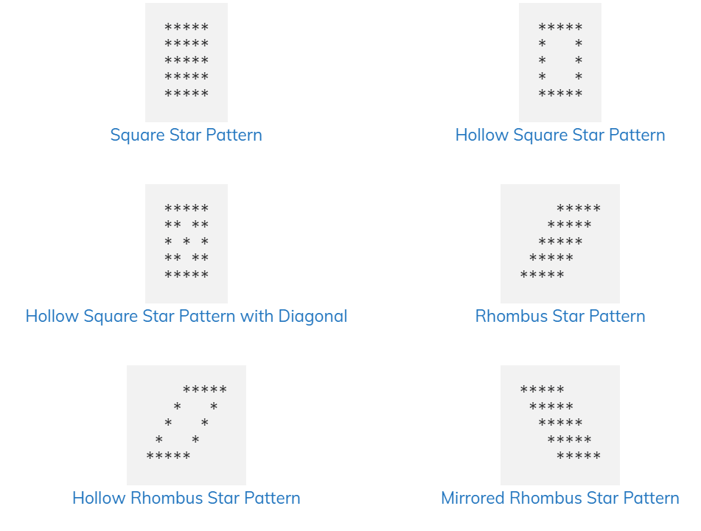
WAP to print these patterns on console

Slide 22
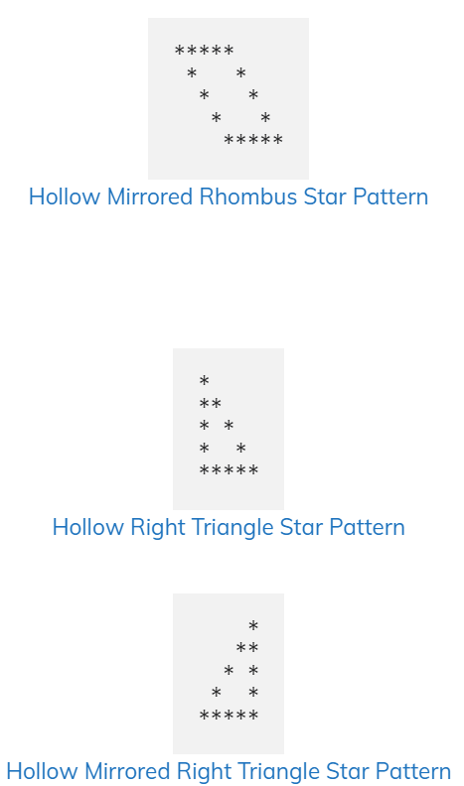
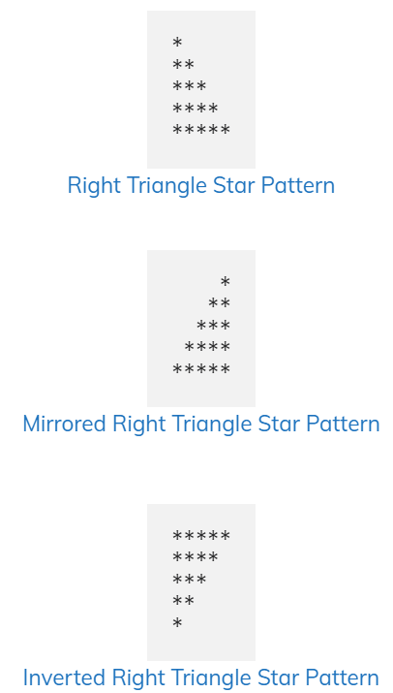
WAP to print these patterns on console

Slide 23
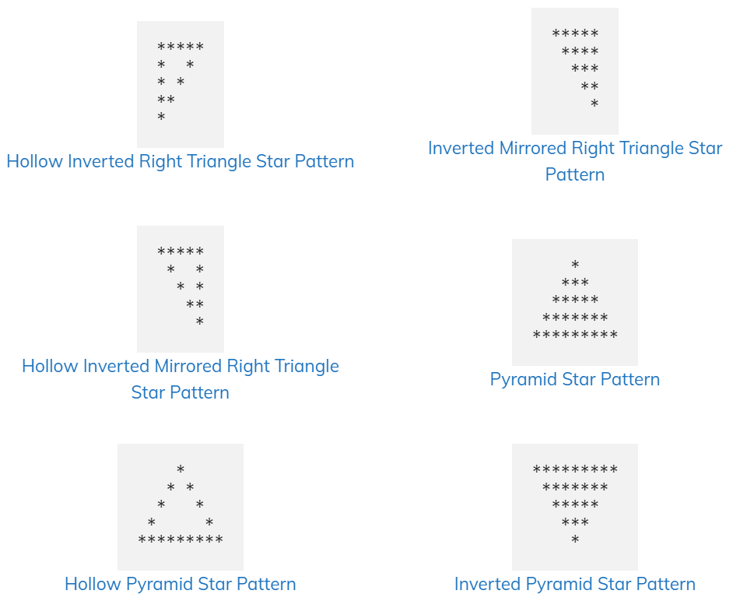
WAP to print these patterns on console

